Slide 1
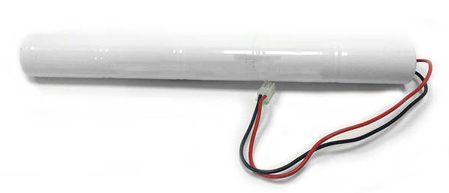
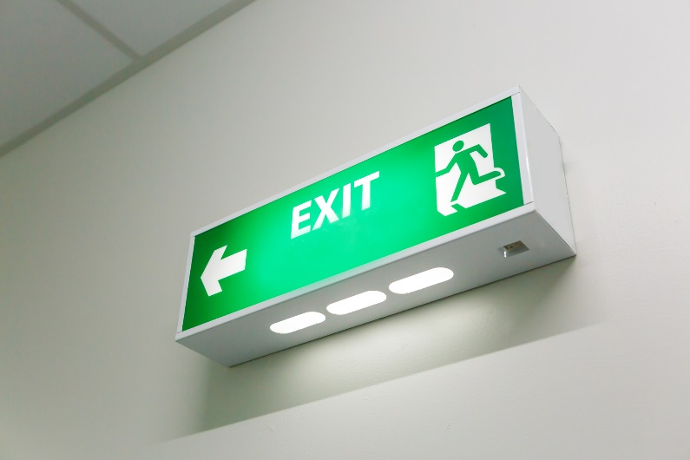


ENEC MARK: SAFETY AT FIRST SIGHT
CELLS & RECHARGEABLE BATTERIES FOR EMERGENCY LIGHTS
HIGH QUALITY EUROPEAN MARK
TO GUARANTEE SAFETY AND COMPLIANCE WITH REGULATORY REQUIREMENTS,
OFFERING ADVANTAGES IN TERMS OF RELIABILITY, INTERNATIONAL RECOGNITION & COMPETITIVE EDGE FOR THE BUSINESS
THE ENEC MARK GUARANTEES COMPLIANCE WITH THE LATEST SAFETY STANDARDS, CERTIFIED BY A THIRD-PARTY BODY
THE EMERGENCY LIGHTING INDUSTRY EXPERIENCES A LACK OF THIRD-PARTY CERTIFIED RECHARGEABLE BATTERIES
ENEC MARK IS SYNONYM OF RELIABILITY, SAFETY AND PRODUCTION SURVEILLANCE
BATTERIES ARE AN IMPORTANT COMPONENT OF EMERGENCY LIGHTING AND THEREFORE
NEEDS CERTIFICATION
CERTIFIED CELLS AND BATTERIES PROVIDE MORE CONFIDENCE TOWARDS LOCAL/NATIONAL AUTHORITIES
BATTERY TECHNOLOGY IS CONTINUOUSLY EVOLVING, WHICH IS WHY IT IS IMPORTANT TO BE RELIABLE
ENEC MARK FOR CERTIFIED COMPONENTS MAKE TESTS ECONOMICAL AND FASTER FOR THE END-PRODUCT MANUFACTURERS
ENEC MARK GUARANTEES OPERATIVITY IN SPECIFIC TOLERANCES
THE MOST KNOWN HIGH QUALITY EUROPEAN MARK IN THE LIGHTING INDUSTRY

Slide 2

OVERVIEW
PRODUCTS
ENEC mark can be issued to:
rechargeable batteries for emergency lighting
cells and batteries intended for other applications
(eg.: battery packs for portable tools or personal electric transporters).
CERTIFICATION PROCESS
Approval of the manufacturer (production site inspection).
TESTING
The type tests can be performed in the:
ADVANTAGES
Battery manufacturers:
competitive edge
guarantee of reliability and standard compliance
production quality monitoring.
Approval of individual product models (type testing on representative sample for the series production).
laboratories of the ENEC members
laboratories of manufactu-
rers*
Lighting manufacturers:
instrument to select a safe and reliable component
mitigating the risks of ha- zards
instrument to simplify and shorten the process of the ENEC certification
cost-effective: reduction of the end-product testing fee.
Certification (granting the license to use the ENEC mark on the products).
*For testing in manufacturer laboratories, there are three processes in place:
E-CTF1 - testing by the ENEC engineer at the manufacturer’s premises
E-CTF2 - testing by the manufacturer’s personnel, witnessed by the ENEC engineer
E-CTF3 - testing by the manufacturer’s personnel – supervised and partly witnessed by the ENEC engineer.
Control of production (yearly supervision of manufacturing location and manufactured products).
MORE CERTIFIED PRODUCTS FOR A SAFER MARKET
XX
- www.enec.com
- www.xxxxxxx
ETICS, the European Testing, Inspection and Certification System | Rue des Deux Églises, 29 - 1000 BRUSSELS – E-mail : secretariat@etics.org

Slide 3

MAIN STANDARDS
PD ERS 001: ENEC Requirement Sheet 001.
To have batteries in the system which comply with these specific requirements, a special program was defined as ENEC Requirement Sheet (ERS) 001.
EN 61951-1 Part 1 Secondary cells and batteries containing alkaline or other non-acid electrolytes - Secondary sealed cells and batteries for portable applications - Part 1: Nickel-cadmium
EN 61951-2 Part 2 Secondary cells and batteries containing alkaline or other non-acid electrolytes - Secondary sealed cells and batteries for portable applications - Part 2: Nickel-metal hydride
EN 61960-3 Part 3 Secondary cells and batteries containing alkaline or other non-acid electrolytes - Secondary lithium cells and batteries for portable applications - Part 3: Prismatic and cylindrical lithium secondary cells, and batteries made from them
EN 62133-1 Part 1 Secondary cells and batteries containing alkaline or other non-acid electrolytes - Safety requirements for portable sealed secondary cells, and for batteries made from them, for use in portable applications - Part 1: Nickel systems
EN 62133-2 Part 2 Secondary cells and batteries containing alkaline or other non-acid electrolytes - Safety requirements for portable sealed secondary cells, and for batteries made from them, for use in portable applications - Part 2: Lithium systems
EN IEC 62619 Secondary cells and batteries containing alkaline or other non-acid electrolytes - Safety requirements for secondary lithium cells and batteries, for use in industrial applications
EN 62620 Secondary cells and batteries containing alkaline or other non-acid electrolytes - Secondary lithium cells and batteries for use in industrial applications
ETICS, the European Testing, Inspection and Certification System | Rue des Deux Églises, 29 - 1000 BRUSSELS – E-mail : secretariat@etics.org

